Slide 1
Mathematics & Statistics
Working on
Patel Hospital Medical Datasets
Supervisor
Dr. Muhammad Waseem
Powered by Muhammad Qasim
Roll no: 19k-1612

Slide 2
Analysis Base on below points:
Age vs Disease
Gender vs Disease
Most common Disease in female
Most common Disease in male
In which year female having most common Disease
In which year male having most common Disease
Male vs Female disease pattern
Most common Disease in male and female
Which year is most crucial for female
Which year is most crucial for male
Visualization of all results

Slide 3
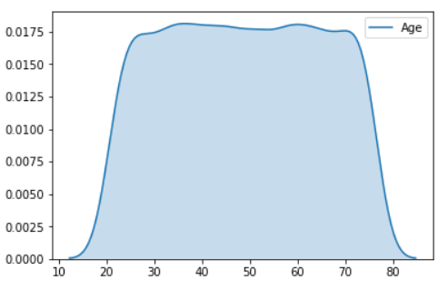
Over All patients Age Distributions:
Patients age starting from 12 to 90
25 to 75 look like uniform distribution

Slide 4
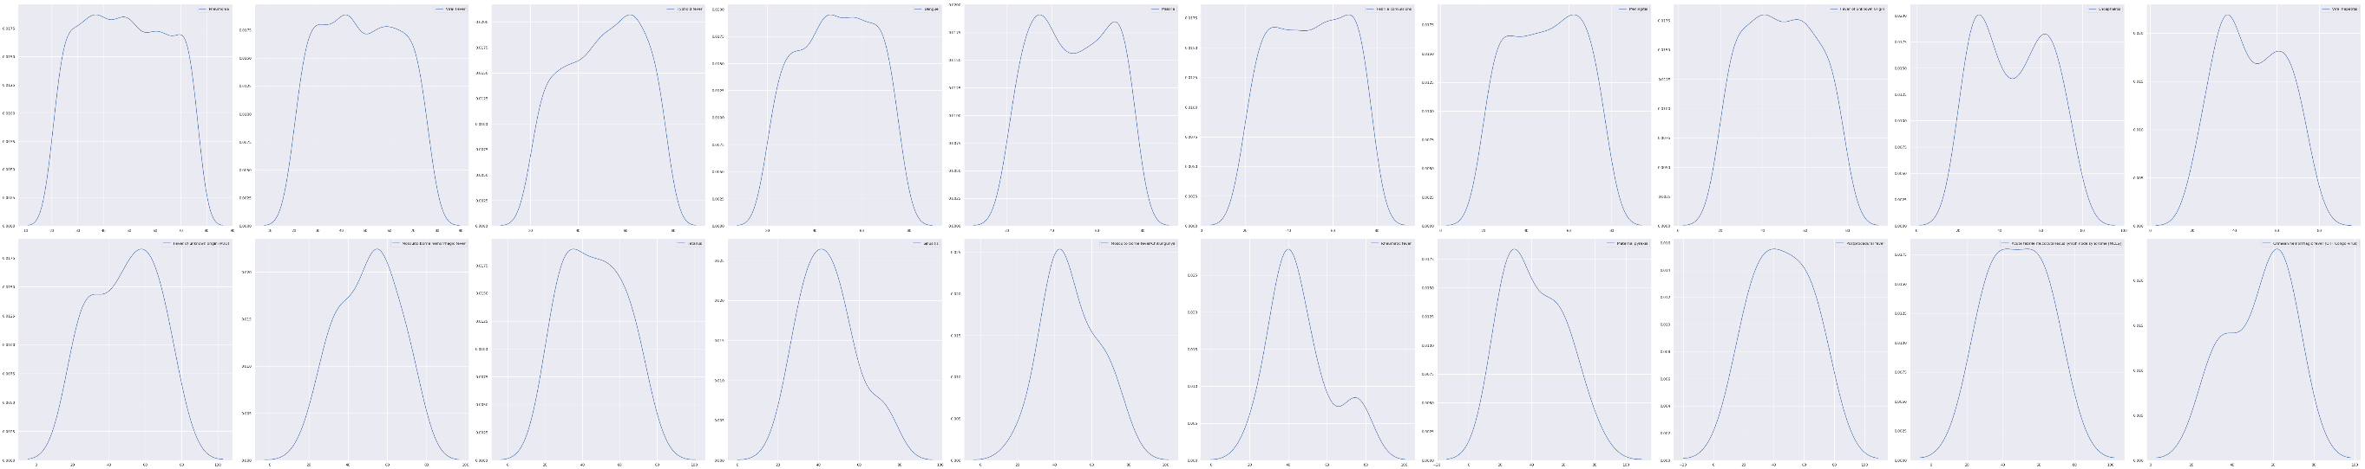
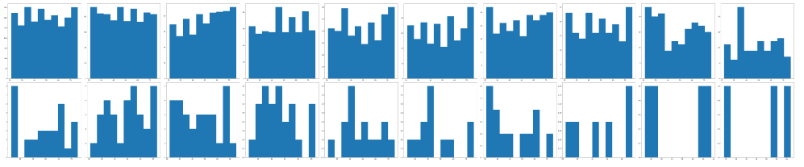
Age vs Disease
Pneumonia
Viral Fever
Typhoid fever
Typhoid fever
Dengue
Malaria
Febrile convulsions
Meningitis
Fever of unknown 0rigin
Encephalitis', 'Viral hepatitis
Fever of unknown
origin (PUO)
Mosquito-borne
hemorrhagic fever
Tetanus
Sinusitis
Mosquito-borne fever
/Chikungunya
Rheumatic fever
Post procedural fever
Acute febrile
mucocutaneous lymph
node syndrome [MCLS]
Crimean
hemorrhagic fever
(CHF Congo virus)
Maternal pyrexia

Slide 5
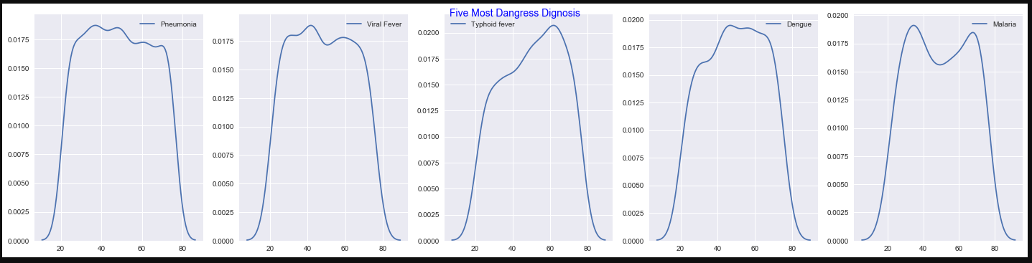
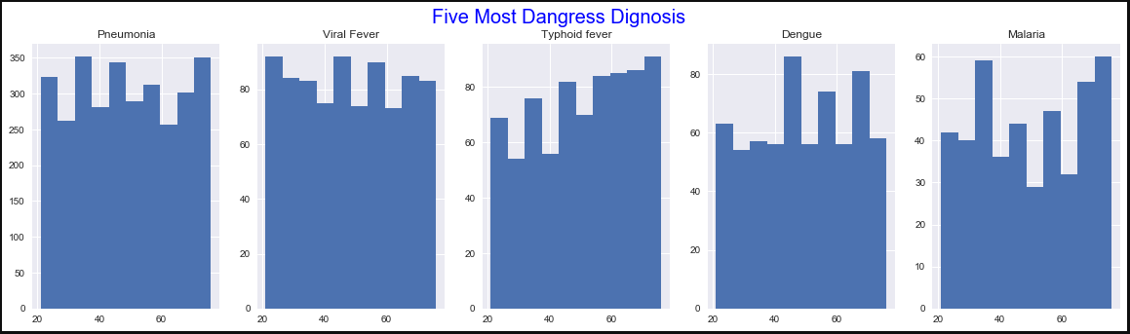
Age vs Disease

Slide 6
Age vs Disease
Phenomena mots effected patients
25 to 55 oldest people
65 to 70 oldest people
Viral Fever most effected patients
20 to 38 or 50 to 55 oldest people
Typhoid most effected patients
55 to 60 oldest people oldest people

Slide 7
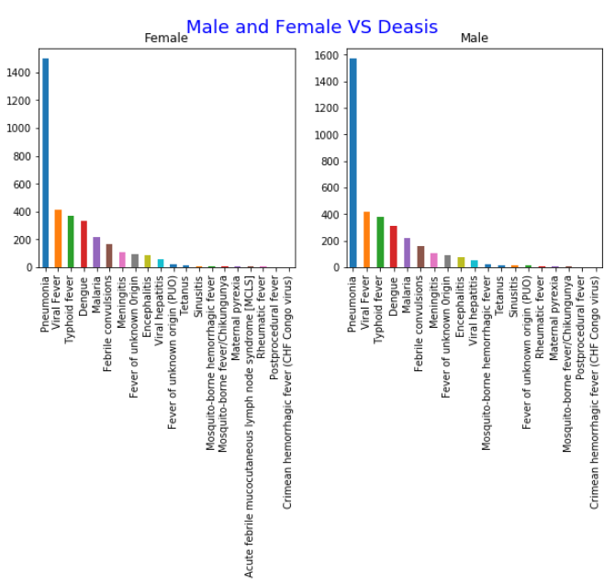
2. Gender vs Disease
Most Common disease in males (3,480)
Pneumonia (1,572)
Viral Fever (418)
Typhoid Fever (381)
Most Common disease in Females (3,427)
Pneumonia (1500)
Viral Fever (413)
Typhoid Fever (372)

Slide 8
2. Gender vs Disease
 | Female Diseases | F_Per | MaleDiseases | M_Per | T.Diseases | T.Diseases_Per
Pneumonia | 1500 | 43.77 | 1572 | 45.17 | 3072 | 44.50
Viral Fever | 413 | 12.05 | 418 | 12.01 | 831 | 12.04
Typhoid fever | 372 | 10.85 | 381 | 10.95 | 753 | 10.91
Dengue | 333 | 9.72 | 308 | 8.85 | 641 | 9.29
Malaria | 220 | 6.42 | 223 | 6.41 | 443 | 6.42
Pneumonia
Effect male more than Females
Most topes disease effect to both
Viral Fever
Effect females more than Males
Typhoid Fever
Effect males more then Females

Slide 9
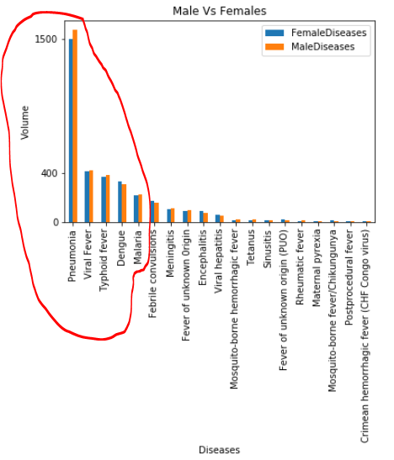
2. Gender vs Disease
Pneumonia
Effect male more than Females
Most topes disease effect to both
Viral Fever
Effect females more than Males
Typhoid Fever
Effect males more then Females

Slide 10
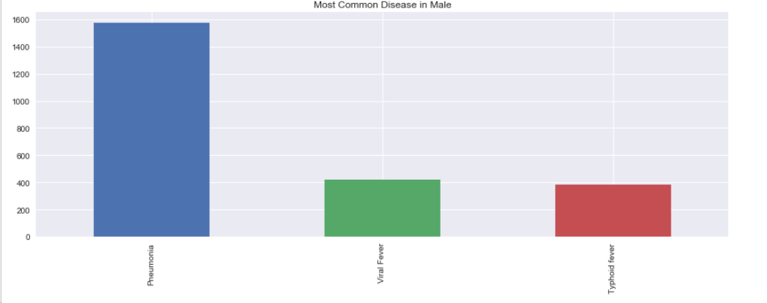
3. Most common Disease in Females
Pneumonia 1500
Viral Fever 413
Typhoid fever 372

Slide 11
4. Most common Disease in Male
Pneumonia 1,572
Viral Fever 418
Typhoid fever 381

Slide 12
5. In which year female having most common Disease
Year: 2018
Total 872
Pneumonia 453
Typhoid fever 123
Viral Fever 61
Year: 2017
Total 848
Pneumonia 346
Viral Fever 170
Typhoid fever 78
Year: 2016
Total 730
Pneumonia 302
Dengue 139
Typhoid fever 68
Year: 2015
Total 578
Pneumonia 235
Dengue 84
Viral Fever 60
Year: 2014
Total 399
Pneumonia 164
Viral Fever 55
Malaria 51

Slide 13
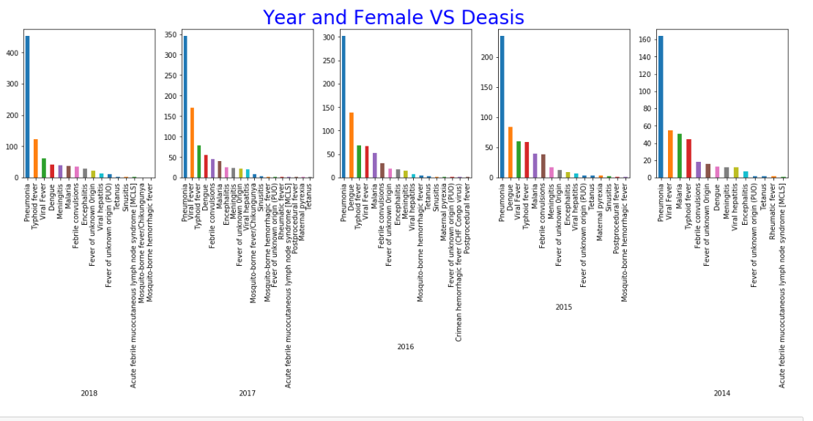
5. In which year female having most common Disease

Slide 14
5. In which year female having most common Disease
Most common disease is “Pneumonia”
Second most common disease after 2016 is “Typhoid”
Viral Fever is 3rd Disease we are facing in 2019

Slide 15
6. In which year Male having most common Disease
Year: 2017
Total 889
Pneumonia 391
Viral Fever 168
Typhoid fever 81
Year: 2018
Total 864
Pneumonia 436
Typhoid fever 115
Viral Fever 71
Year: 2016
Total 743
Pneumonia 327
Dengue 110
Typhoid fever 71
Year: 2015
Total 563
Pneumonia 249
Dengue 65
Viral Fever 63
Year: 2014
Total 421
Pneumonia 169
Typhoid fever 64
Viral Fever 48

Slide 16
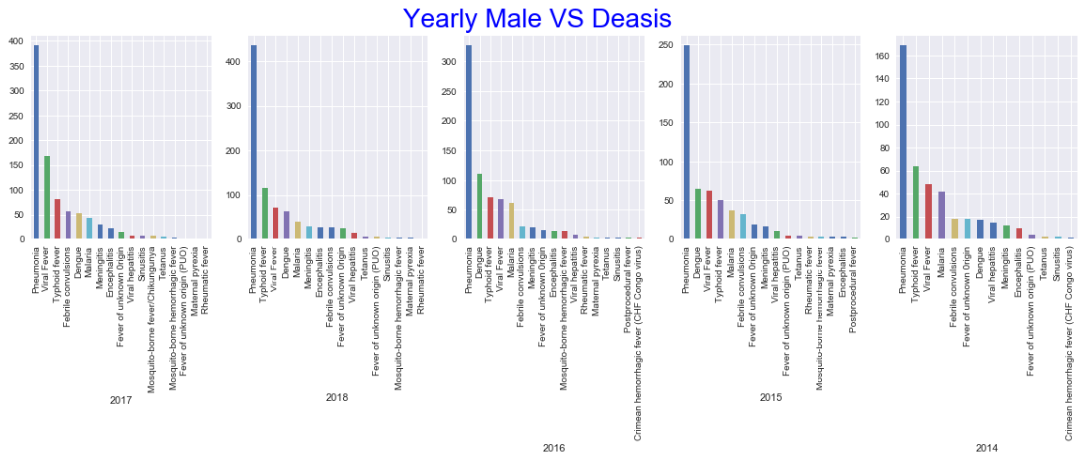
6. In which year male having most common Disease

Slide 17
6. In which year female having most common Disease
Most common disease is “Pneumonia”
Second most common disease after 2016 is “Typhoid”
Viral Fever is 3rd Disease we are facing in 2019

Slide 18
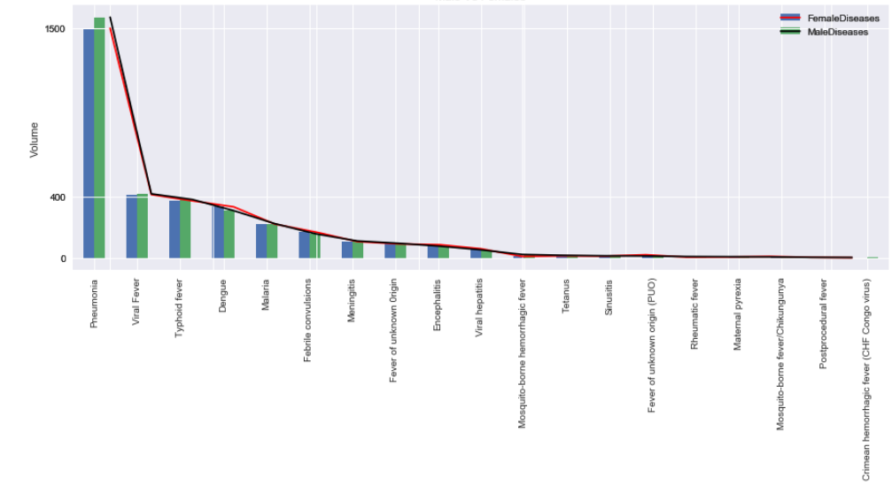
7. Male vs Female disease pattern

Slide 19
8. Most common Disease in male and female

Slide 20
6. In which year Male having most common Disease
Year: 2018
Total 872
Pneumonia 453
Typhoid fever 123
Viral Fever 61
Year: 2017
Total 848
Pneumonia 346
Viral Fever 170
Typhoid fever 78
Year: 2016
Total 730
Pneumonia 302
Dengue 139
Typhoid fever 68
Year: 2015
Total 578
Pneumonia 235
Dengue 84
Viral Fever 60
Year: 2014
Total 399
Pneumonia 164
Viral Fever 55
Malaria 51

Slide 21
9. Which year is most crucial for Male
Year: 2017
Total 889
Pneumonia 391
Viral Fever 168
Typhoid fever 81
Year: 2018
Total 864
Pneumonia 436
Typhoid fever 115
Viral Fever 71
Year: 2016
Total 743
Pneumonia 327
Dengue 110
Typhoid fever 71
Year: 2015
Total 563
Pneumonia 249
Dengue 65
Viral Fever 63
Year: 2014
Total 421
Pneumonia 169
Typhoid fever 64
Viral Fever 48

Slide 22
10. Visualization of all results
Seaborn, matplotlib and pandas plot
Bar chart, line chart
Subplots

